Slide 1

Predicting Popular Recipes
A solution for high-traffic forecast
Notes:
Self Introduction
How we have approached the problem of predicting high-traffic recipes for our website

Slide 2
Business Goals
A solution for choosing which recipe will be shown on the home page.
A solution to predict which recipe will lead to high traffic (An increase of about 40% in traffic), with 80% of correct forecasts.
A solution for an automated fast decision process for picking the recipe.
Notes:
The product team noticed that some recipes have an increase in 40% of traffic when shown on the home page.
The process of choosing the recipes to be shown in the home page is manual, and there is no constraints when choosing the recipe.
We want to support the product team in creating a machine learning model that can predict with 80% correct guests which recipe should be shown on their home page.

Slide 3
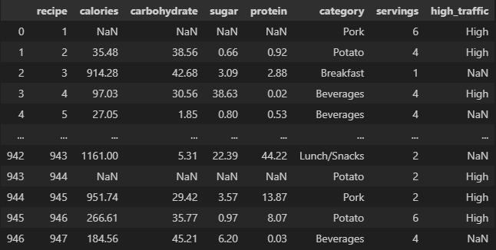
Data
Missing Values
Category Mismatch
Type Inconsistency
Missing Target Variable
Notes:
The data provided contains 947 observations and eight columns
The data consists of information displayed to our clients and internal information on the website traffic.
The high-traffic label highlights if there was an increase of 40% in traffic when using the recipe on the home page.
In the data, I had to deal with:
missing values for some observations: Some recipes didn’t have their nutrients
Incorrect category type: ‘Chicken Breast’ and ‘Chicken’ should be in the same category
Type Inconsistency: Some observations had the number of servings and a string following, for example: ‘4 as a snack’
Missing Target Variable: The target variable, high traffic, had null values for the recipes that didn’t bring high traffic.

Slide 4
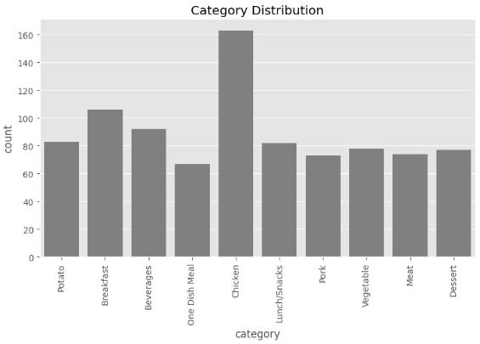
Key Findings
In this dataset, we have ten different categories.
Potato
Breakfast
Beverages
…
Notes:
The data is very balanced between **category**, except for the "Chicken" category, which has almost double the number of samples.

Slide 5
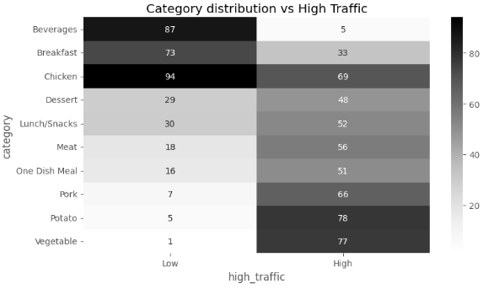
Key Findings
The table shows how many recipes from each category were responsible for High Traffic or not.
Big positive difference in ‘Vegetable’, ‘Potato’, and ‘Pork’,
To increase traffic, we can add recipes that are more likely to bring high traffic and reduce the unlikely others on our homepage.
Notes:
When analysing the relationship between the feature category and the target feature, high traffic, I noticed that 'Vegetable', 'Potato' and 'Pork' meals are more likely to bring high traffic. In contrast, 'Beverages', 'Breakfast', and 'Chicken' are unlikely to bring High traffic.
For example, when a ‘Vegetable’ recipe was shown on our home page, our website reached a high volume traffic seventy-seven times, and it didn’t achieve high traffic only once.
To increase traffic, we can add recipes that are more likely to bring high traffic and reduce the unlikely others on our homepage.

Slide 6
Model Development
calories
carbohydrate
Logistic Regression
High Traffic Recipe 1
sugar
protein
Random Forest Classifier
High Traffic Recipe 2
category
servings
The same features were used for training two models.
Notes:
I used two models to decide which performs better and solve our problem.
The Logistic Regression is more strong for linear patterns.
The Random Forest can capture non-linear models.

Slide 7
Outcomes
I used two metrics to evaluate the models: Precision and Specificity
Metrics | Precision | Specificity
Purpose | How likely we are to predict a High Traffic Recipe | How likely we are to predict a Normal Traffic Recipe
Range | 0-1 | 0-1
Notes:
Precision is crucial here because it helps measure how well the model predicts high-traffic recipes. We like that this value is above 80% for the company goal.
Specificity helps ensure that we avoid showing too many unpopular recipes, aligning with the goal of reducing the risk of low-traffic content.
We want both metrics to be as high as possible.

Slide 8
Outcomes
The Logistic Regression is performing better and it is aligned with the company goal
Model Name | Precision | Specificity
Logistic Regression | 0.80 | 0.70
Random Forest Classifier | 0.77 | 0.64
Notes:
The Precision value of the Logistic Regression model is approximately 0.80, indicating that the model correctly predicts high traffic recipes 80% of the time. In comparison, the Random Forest Classifier achieves a Precision of about 0.77.
When evaluating Specificity, the Logistic Regression model shows a Specificity of approximately 0.70, the Random Forest Classifier has a Specificity of around 0.65.
Overall, the results demonstrate that the Logistic Regression model not only has a higher Precision but also better Specificity compared to the Random Forest Classifier. This suggests that Logistic Regression is more effective in minimizing the chances of incorrectly predicting recipes that will generate low traffic, aligning with the goal of the analysis.

Slide 9
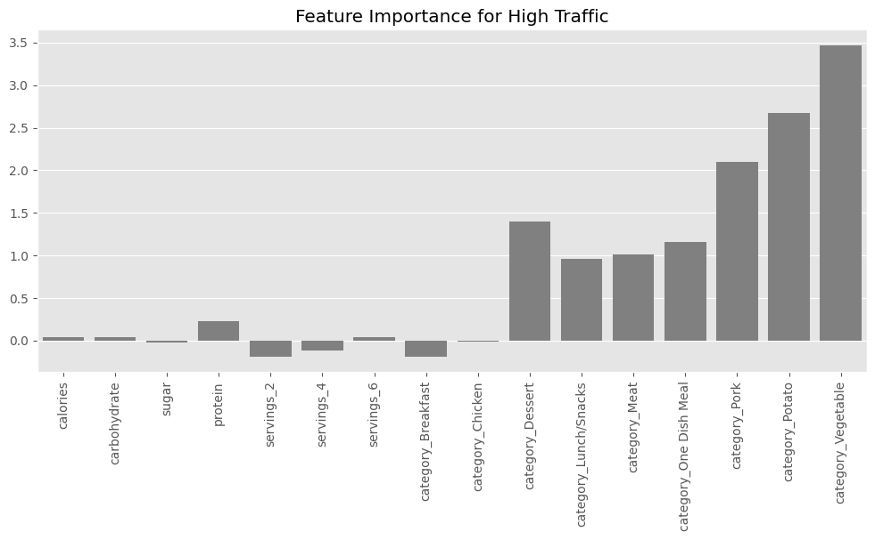
Outcomes
Logistic Regression
The most critical features for prediction are from the category features.
Notes:
In line with our first data exploration, we see that the category of our recipes greatly influences our traffic.
Recipes with 'Vegetable', 'Potato', and 'Pork' are very likely to drive high traffic, I recommend increasing the number of recipes within these categories.

Slide 10
Recommendation
Test Logistic Regression performing an A/B. Show some visitors only recipes that the model predicted as high traffic and compare with the control group.
Evaluate model performance by comparing how many times the model suggests recipes with high traffic, and this happened. The model should correctly predict 80% of the time.
Identify and fix errors after testing.
Deploy the model on the website.
Gather additional data over time to refine and enhance the model’s precision, ensuring it adapts to changing trends in recipe popularity.
Notes:
To achieve the goal of predicting high-traffic recipes, I recommend utilizing the Logistic Regression model. With the Logistic Regression model achieving approximately 80% precision, we can expect reliable identification of recipes that will generate high traffic. To ensure effective implementation and continuous improvement, I suggest the following steps:

